Slide 1
Code: 26906366

Slide 2
OOP – Week 4
Looping
Dr. Jizheng Wan
Oct 2023

Slide 3
Learning Objectives
Understand how for loop works.
Understand the Nested loop.
Understand Loop control statements.
  break.
  continue.
How to improve the performance of a loop.

Slide 4
for Loop
Difference between while loop and for loop
Initialization
Initialization
Condition
Alteration
int i = 0;
while (i < 3) {
// loop body
i++;
}
Condition
for (int i = 0; i < 3; i++) {
// loop body
}
Alteration
while loop
for loop

Slide 5
for Loop
Syntax
Keyword: for
Parentheses: ()
  Initializing the loop control variable.
  Testing the loop control variable.
  Updating the loop control variable.
  N.B. Separated by: ;
Loop body within {}.
Initialization
Condition
Alteration
for (int i = 0; i < 3; i++) {
// loop body
}
for loop
Example: LoopExample5_ForVote

Slide 6
for Loop
Variations in for loops
Initialization of more than one variable.
Performance of more than one test using AND or OR operators.
Altering more than one value.
Example: LoopExample6_ForVariation

Slide 7
for Loop
Enhanced for loops (For-Each Loop)
Iterate over arrays or collections without needing to manage an index variable.
for (DataType item : collection) {
// loop body
}
Example: LoopExample6_3_EnhancedFor

Slide 8
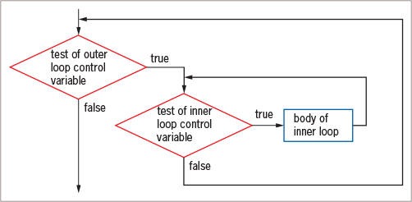
Nested Loop
A loop inside another loop.
Can combine different types of loops (for, while, do-while).
The inner loop must be entirely contained in the outer loop.
Example: LoopExample7_NestedLoop

Slide 9
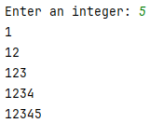
Nested Loop
Example
Write a Java program that prompts the user for an integer n and then prints a pattern of numbers from 1 up to n in ascending order.
LoopExample7_NestedLoop

Slide 10
Loop control statements
break and continue
Use these two control statements to change the loop behaviour:
break: exits the loop entirely.
  Commonly used in a search scenario – exists the loop when the target is found.
continue: skips the current iteration and continues with the next one.
  Skipping invalid data or outliers in data processing.
Example: LoopExample8_Break and LoopExample9_Continue

Slide 11
Improve Loop Performance
Avoiding Unnecessary Operations
while (x < a + b) {
// loop body
}
int sum = a + b;
while (x < sum) {
// loop body
}
The code on the right is more efficient than the code on the left, as it doesn’t need to recalculate the sum in every iteration.

Slide 12
Improve Loop Performance
The Order of Evaluation of Short-Circuit Operators
Short-circuit operators are logical operators in programming (e.g. && and ||) that only evaluate the second operand if the first operand doesn't determine the outcome.
Example: LoopExample10_SCO
For the && operator, test the least likely occurrence first.
For the || operator, test the most likely occurrence first.

Slide 13
Improve Loop Performance
Comparing to Zero
Making a comparison to zero (0) is faster than making a comparison to any other value.
To improve loop performance, compare the loop control variable to zero (0) if possible.
Avoid: for (int i = 0; i <= 9999; i++)
Instead: for (int i = 9999; i >= 0; i--)

Slide 14
Common Mistakes
Forget to alter the control variable – Infinite loop.
Loop condition always be true. E.g.
  for (int i = 0; i < 3; i--) – Infinite loop.
Misuse the semicolon:
  while (i < 3); -- Empty loop body.
  for (int i = 0; i < 3; i++); -- Empty loop body.
  do {//loop body} while (i < 3) – Syntax error.
Forget to include {} when there are more than one statements. – Incomplete loop body.
Repeat steps within a loop that could just as well be placed outside the loop – Poor performance.

Slide 15

Q & A
Code: 26906366

